Slide 1
The use of data mining and neural networks for forecasting stock market returns David Enke, Suraphan Thawornwong 2005
Re-implementation by Sunay Lalchandani (11290018 ) & Joel Cappelli (12137384)
UTS
49275 Major Project
June 2016

Slide 2
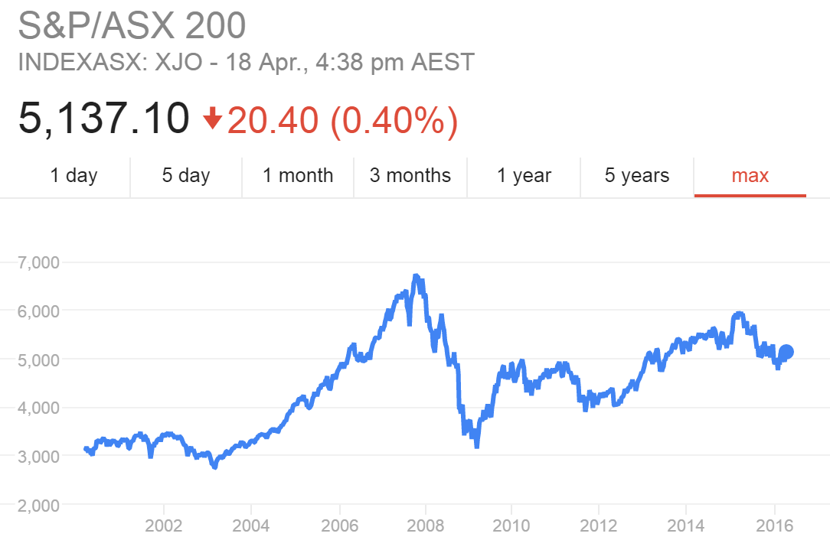
Motivation – Aussie stock market
It has been widely accepted by many studies that non-linearity exists in the financial markets and that neural networks can be effectively used to uncover this relationship.
The S&P/ASX 200 XJOA is recognized as the institutional investable benchmark in Australia.
The index covers approximately 80% of Australian equity market capitalization.

Slide 3
Literature review – Neural Networks in Finance
412 articles published between 1994 and 2015
Multilayer feedforward network with gradient descent backpropagation most common.
Hybrid learning and architecture methods are emerging to be more popular.
Application in shares/bonds and bankruptcy and financial distress prediction most common.
Stock trading guided by prediction of the sign of stock return more profitable.
Michal Tka, Robert Verner (2016) Artificial neural networks in business: Two decades of research; Applied Soft Computing 38 (2016) 788–804
Mark T. Leunga, Hazem Daoukb, An-Sing Chenc (2000) Forecasting stock indices: a comparison of classification and level estimation models

Slide 4
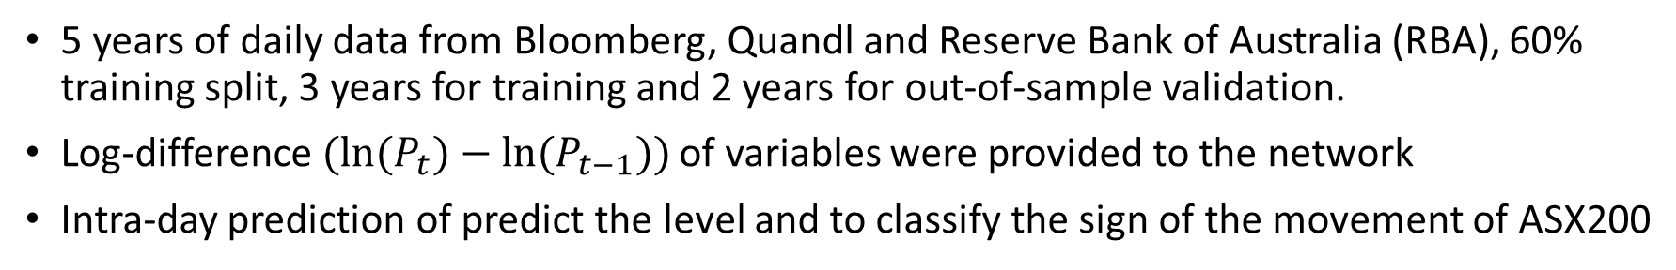
System overview – daily predictions of ASX200
Stock direction network
(+/-)
Input variables
Global market indices
Treasury and/or government bonds
Dividend yield of ASX200
FX Rates, USD/Yen, USD/JPY, AUD/USD
Commodities (gold, oil, iron ore)
Data mining and feature selection
Information gain analysis
Compute log-diff of each input variable
Standardise inputs
Max-min outputs
Apply trading rules
Stock return network
(x %)
5 years of daily data from Bloomberg, Quandl and Reserve Bank of Australia (RBA), 60% training split, 3 years for training and 2 years for out-of-sample validation.
Log-difference $(ln(P_{t})−ln⁡(P_{t−1}))$ of variables were provided to the network
Intra-day prediction of predict the level and to classify the sign of the movement of ASX200

Slide 5
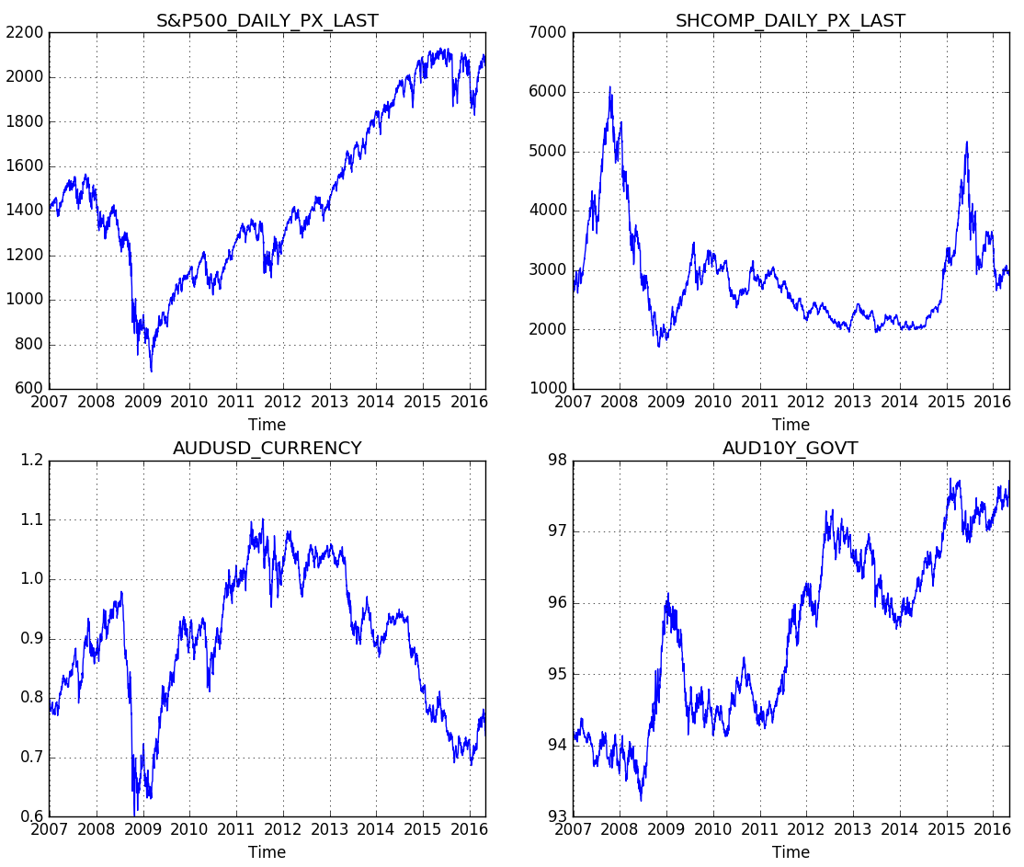
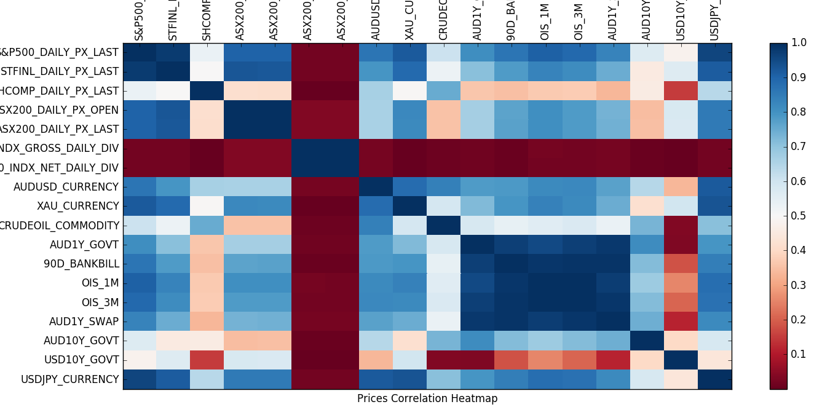
Inputs to the Neural Network
S&P 500 (U.S.)
S&P/TSX Financials Sector Index (Canada)
Shanghai Composite Index (China)
S&P/ASX 200 Daily Dividends
Gold (Commodity)
WTI Crude Oil (Commodity)
AUD/USD (Currency)
USD/JPY (Currency)
Australian 90 Day Bank Bill
Australian Government 10 Year Bonds
United States 10 Year Treasury Note
List of inputs and lags
Few charts
The project will be implemented in Python
Use of open source libraries such as neuPy and scikit-learn which have a number different learning algorithms and network architectures to experiment with.
RUN HERE

Slide 6
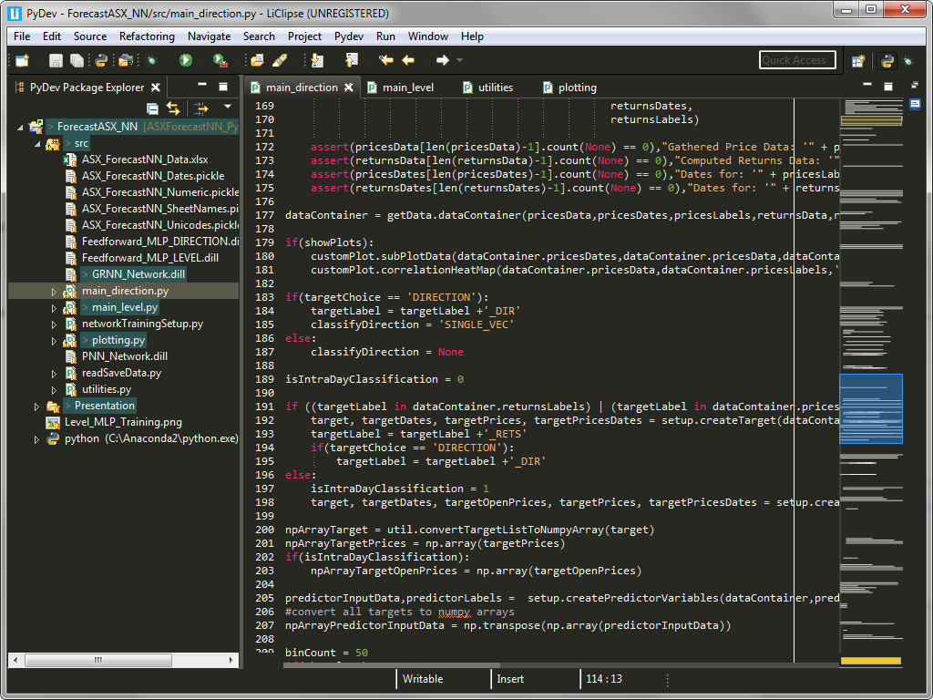
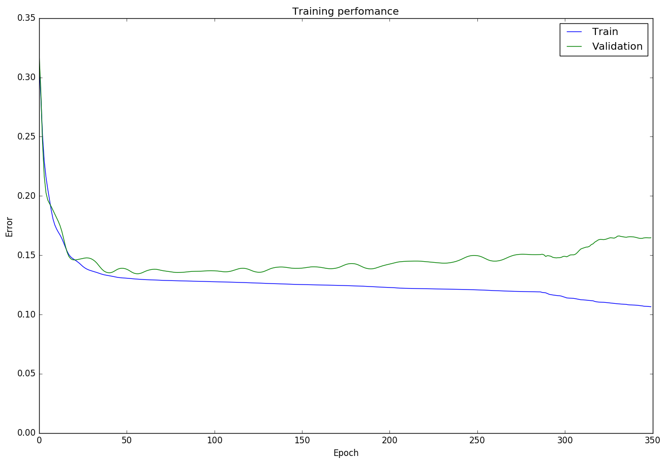
Implementation
Python 2.7
Utilises open-source libraries, such as NeuPy and scikit-learn.
The input data is first cleaned and aligned based on a specified lag before being fed into the neural networks.
Used conjugate gradient optimisation for network learning
Runtime performance is very dependent on the time horizons and number of inputs we select.
Optimal network architecture with bias at each hidden node
input layer<11>, tanh<22>,output layer<1>

Slide 7
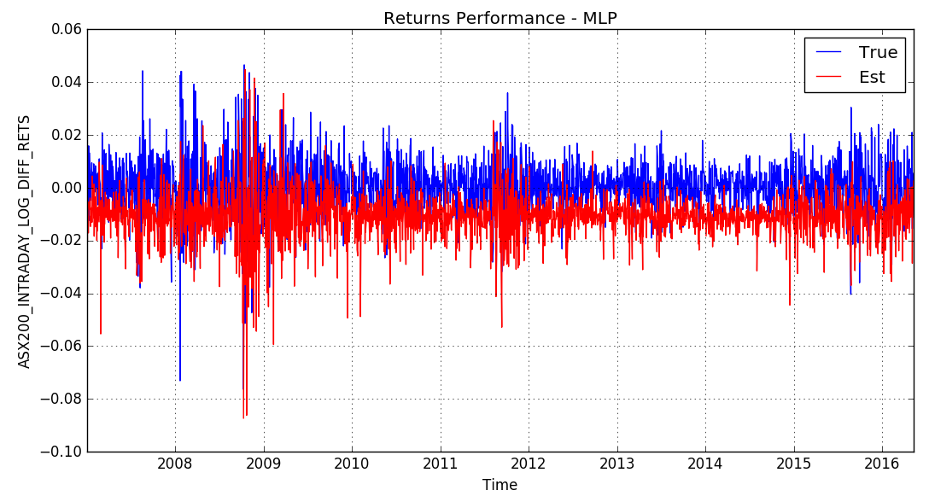
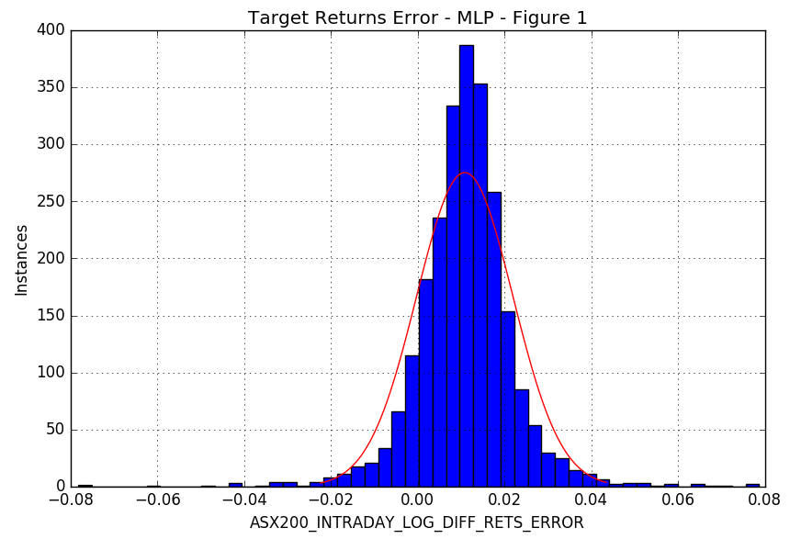
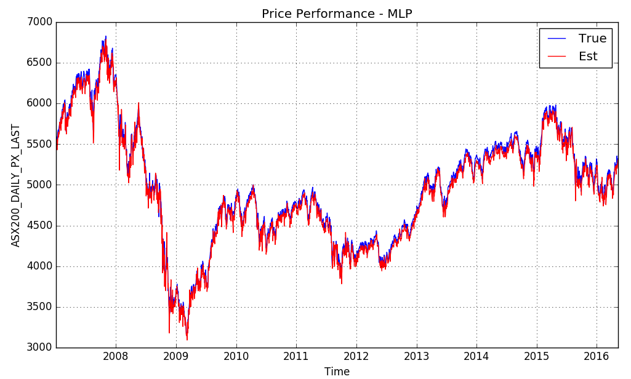
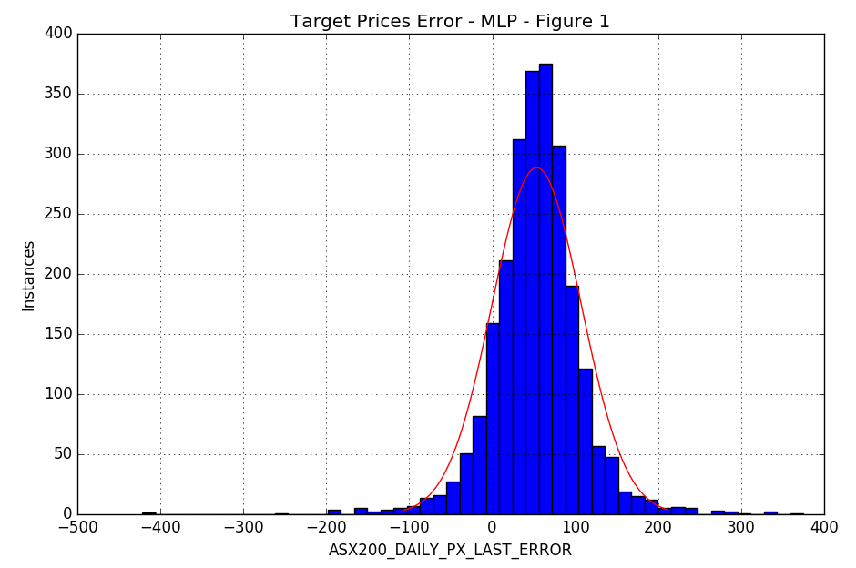
Performance: March 2007 – May 2016
Daily direction 1278 days out of 2439 days = 52% correct
Training Period
Training Period

Slide 8
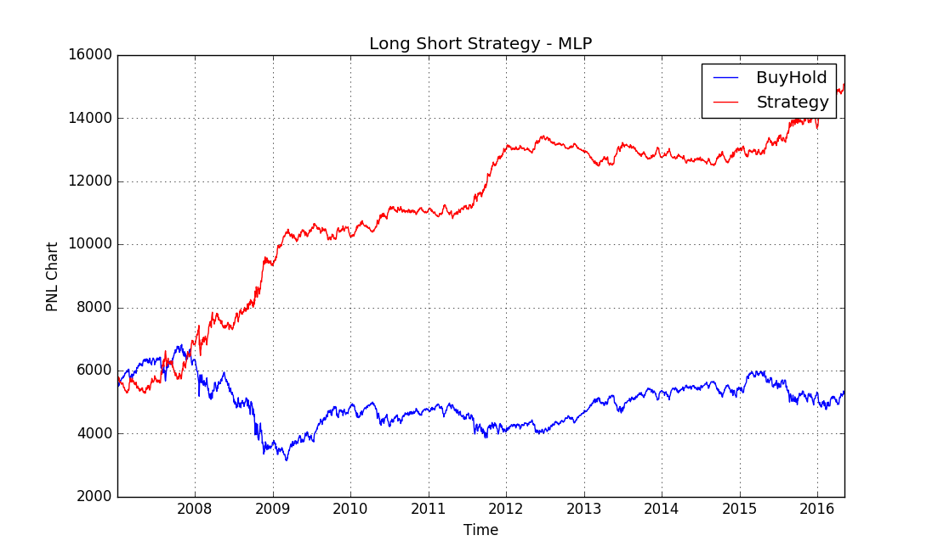
Validation Results
A trading simulation was developed to further compare our results to a typical buy-and-hold strategy.
We compared two hypothetical portfolios, one representing the ASX200 and another investing based on the buy/sell signals generated by our neural network.
Results look promising but further testing is required!

Slide 9
Conclusion
Results we obtained using RMSE and accuracy percentage were promising, and broadly inline with what was achieved in the paper.
There does appear to be inefficiencies in the market we can exploit.
The trading simulation showed better than expected results, and could be enhanced to account for dividends, taxes and transaction costs to produce a more realistic P&L.
Further work can be done to optimise the input selection and neural network parameters.
We can also look at applying more rigorous testing against different time frames and market conditions to ensure our results are consistent and not just a statistical anomaly.

Slide 10
References
David Enke, Suraphan Thawornwong (2005), The use of data mining and neural networks for forecasting stock market returns; Expert Systems with Applications 29 (2005) 927–940
Mark T. Leunga, Hazem Daoukb, An-Sing Chenc (2000) Forecasting stock indices: a comparison of classification and level estimation models; http://papers.ssrn.com/sol3/papers.cfm?abstract_id=200429
Michal Tka, Robert Verner (2016) Artificial neural networks in business: Two decades of research; Applied Soft Computing 38 (2016) 788–804
Rodolfo C. Cavalcante, Rodrigo C. Brasileiro b , Victor L.F. Souza b , Jarley P. Nobrega, Adriano L.I. Oliveira (2016) Computational Intelligence and Financial Markets: A Survey and Future Directions; Expert Systems With Applications 55 (2016) 194–211

